Slide 1
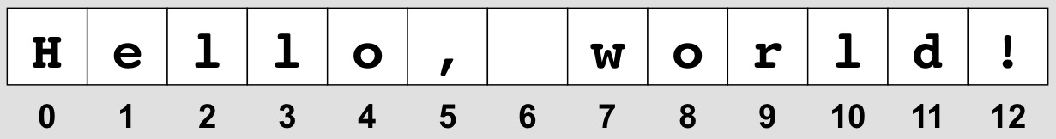
Strings

Slide 2

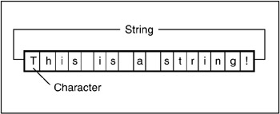
Strings
Strings are the most essential part of C# programming language, and also is one of the important data types in modern languages including C#.
The string data type is a collection of characters (char) in which each character is a Unicode character.
They can be manipulated in the same way as an array, meaning that individual characters can be identified and used

Slide 3
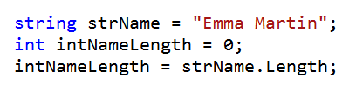
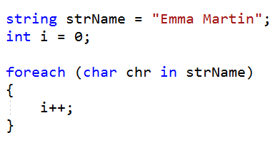
Length of a String
To find the length of a string (how many characters it contains) use the Length property.
You could also do this using a loop:

Slide 4
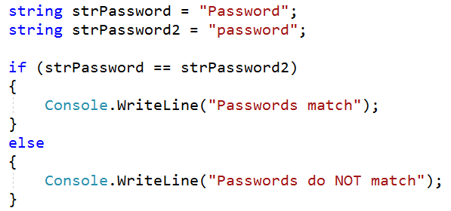
String Case
It is important to remember that each character is associated with it’s own unique character code (Unicode or Ascii).
This is especially important if you are trying to compare two strings.
In the example below, the else part of the code would be executed.

Slide 5

Changing case
In C#, ToUpper() is a string method.
It converts every character to uppercase (if there is an uppercase version).
If a character does not have an uppercase equivalent, it remains unchanged e.g. special symbols
Alternatively, ToLower() will convert every character to lowercase.

Slide 6

Checking Case
In C#, Char.IsUpper() is a method which is used to check whether a Unicode character can be categorized as an uppercase letter or not.
This method can only be used on individual characters and not on a whole string.
The alternative method would be Char.IsLower()

Slide 7

Finding a Character
In C#, IndexOf() is used to find the zero based index of the first occurrence of a specified character or string within a given string.
The method returns -1 if the character or string is not found.
The example below would return 1 (remember that the index of an array starts at 0)

Slide 8

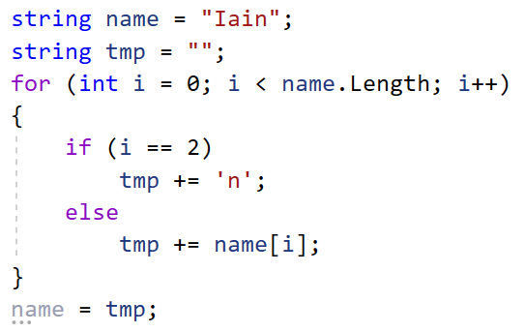
Replacing
You cannot replace a letter in the middle of a string.
It’s a nice idea but you can’t… you have to copy the string until you get to the letter you want to change:

Slide 9
Task
Write a console program that take in a word or sentence. It then changes it to:
Bumpy case
Word case
Number plate mode
Output from “hello world”:
(a)HeLlO wOrLd <-ignores spaces
(b)Hello World <-uses spaces
(c) H3110 W0R1D <-replaces certain letters and uses caps

